Slide 1
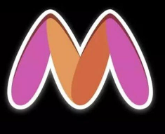
Theme 3: : Trend Demand Forecasting(Using Multimodal Approach)

Slide 2
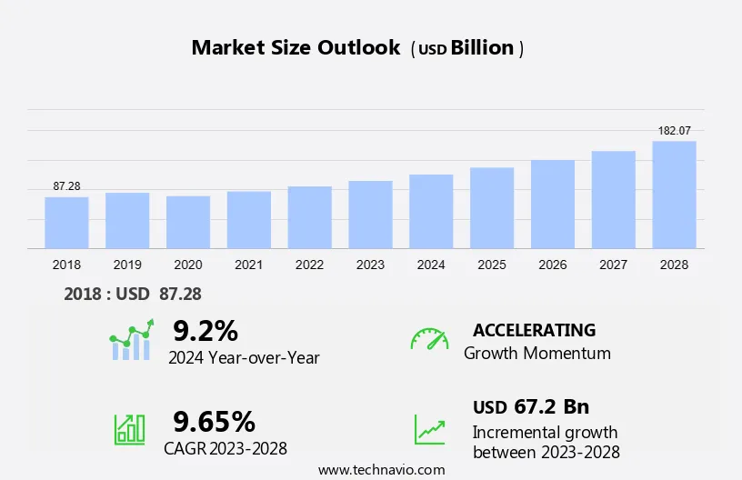
Problem with the existing system
Fashion Retailers try to draw inspiration from external sources such as e-commerce portals and online fashion magazines to design the next set of fashion products that they can launch in order to delight the customer. However, it is a manual effort intensive process, requiring a large team of fashion designers. In order to reduce dependency and make the overall process more efficient, we want to create a scalable tech solution to extract winning designs of apparel to design upcoming batches of fashion products.
Ask the question why is most popular item specifically popular. It's amazing what a small difference between two products makes one favored over the other.

Slide 3
What is the scale and Impact of the Problem?
Scale of the Problem:
The fashion industry is a vast and constantly evolving market, with global revenues estimated to reach over $2 trillion by 2025. Fashion retailers, both online and offline, face the challenge of staying ahead of the curve and meeting the ever-changing demands of their customers. Currently, the process of designing and developing new fashion products is heavily reliant on manual efforts from teams of fashion designers, who must sift through numerous sources, such as e-commerce portals and fashion magazines, to identify winning designs and trends.
Impact of the Problem:
The reliance on manual, labor-intensive processes to design new fashion products can have significant consequences for fashion retailers, including:
Reduced Competitiveness: The slow pace of the current design process can make it difficult for fashion retailers to quickly respond to market trends and introduce new, desirable products, ultimately impacting their competitiveness in the market.
Increased Costs: The large teams of fashion designers required to manually sift through data sources and identify winning designs can be a significant cost burden for fashion retailers, especially for smaller and medium-sized businesses.
Missed Opportunities: By not effectively leveraging the wealth of data available from e-commerce portals and online fashion magazines, fashion retailers may be missing out on valuable insights and opportunities to create products that truly resonate with their customers.

Slide 4
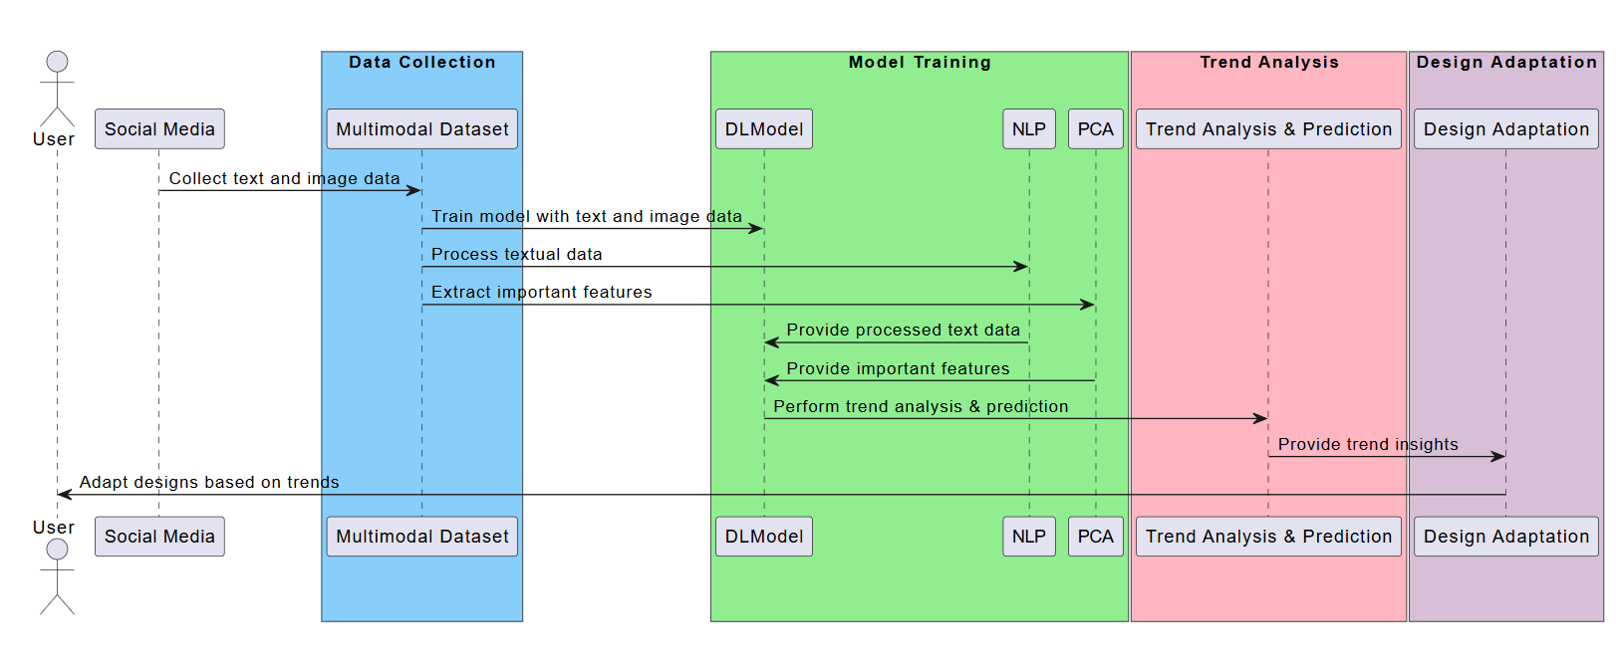
Solution that we are proposing
Social media plays a significant role in shaping fashion trends. Platforms offering social media analytics track mentions, engagement levels, sentiment analysis, and influencer activity across various social media platforms. By analyzing social media data, we can identify emerging trends, monitor brand perception, and leverage influencer partnerships to amplify their reach. These insights enable you us quickly adapt your designs to align with popular trends. By tapping into the pulse of social media, we can ensure our collections are timely, relevant, and appealing, effectively capturing the attention of your target audience.

Slide 5
The solution being proposed in the given text is a multi-pronged approach to identify and predict fashion trends using various data sources and techniques. The key components of the proposed solution are:
E-commerce Website Data Analysis:
first we will Gather data from popular e-commerce websites like Flipkart, Amazon, H&M, and Nordstrom.
Then we will Analyze key metrics such as reviews, ratings, and the number of reviews to gain insights into current trends.
After that we will Extract specific product features (e.g., neckline, prints, colors, fit) from product descriptions using techniques like named entity recognition or bigram analysis.
And then Analyze the extracted features to identify trending elements in different clothing categories.
Utilize the Myntra Dataset and a multimodal dataset to train the fashion trend prediction model.
Celebrity and High-End Fashion Influence:
For this we will first Scrape images from celebrities' Instagram handles, fashion blogs, and online magazines like Vogue.
Then we will Analyze the data to identify features and styles that are gaining popularity among celebrities and high-end fashion influencers.
Lastly, we will Use this data to predict future fashion trends.
Social Media Hashtag Analysis:
First Scrape the latest fashion images using popular hashtags and search terms on platforms like Instagram and Pinterest.
Then we will Analyze the data to understand what is currently in fashion and identify emerging trends.
Then Use the data from fashion weeks to help forecast future fashion trends.

Slide 6
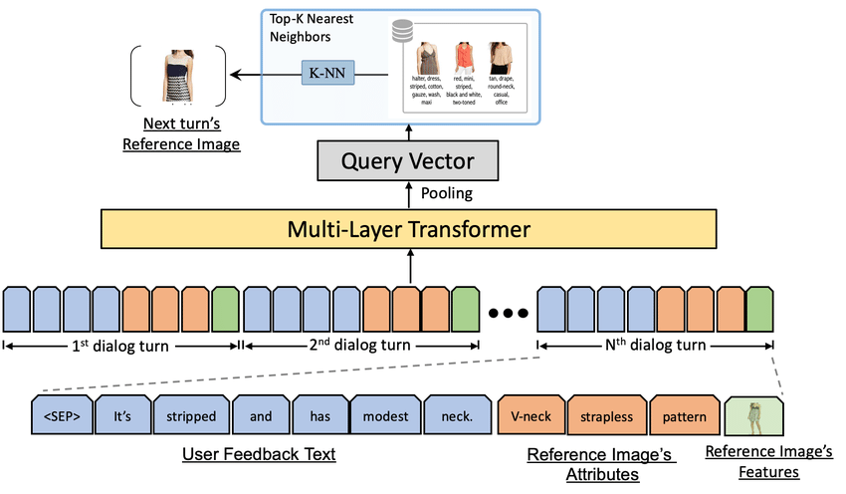
What is the feasibility of implementing the solution?
This project aims to predict future fashion trends by analyzing Instagram posts. It uses a mix of machine learning techniques, image processing, and sentiment analysis to group similar fashion styles and assess public sentiment toward them. Here we are implementing well-established techniques, such as image segmentation, feature extraction to accurately identify the features(ex. patterns, floral prints, necklines, etc.), clustering, and a bit of sentiment analysis. In addition to that for the project, we are collecting the data from various means like e-commerce platforms, social media sites, and fashion magazines and also scraping hashtag data from online. by making use of the Multimodal dataset collected from various places we can achieve better results as compared to traditional text datasets

Slide 7
Tech Stack used and Benefits of the Solution
The concepts and tech stack used here are:
Web scraping (Python)
Natural Language Processing (Python)
a. Sentiment Analysis
b. Bigram Analysis
Data Visualizations (Flask APIs, d3.js)
Social media is a vital tool for understanding fashion trends. These insights enable us to quickly adapt our designs to align with popular trends. By tapping into the pulse of social media, we can ensure our collections are timely and relevant.
By Building our model by using deep learning and natural language processing we can combine both text and image data for trend analysis and prediction.
Using PCA we are making sure to include only important features that predict the results to enhance the accuracy
Will also be useful for future trend prediction ahead of anyone else using technology and stats.
Python: for the project we will use Python, a powerful and versatile programming language that is widely used in data science and machine learning.
YOLO & SAM: These algorithms will be used for image segmentation.
PCA & KMeans: These techniques will be used for dimensionality reduction and clustering.
AdaBoost: This machine learning algorithm we will use for sentiment analysis.
By using the multimodal dataset for the trend identifications and prediction design we can obtain much better results as compared to that of the traditional text and sentiments related data. by combining the traditional methodologies with the multimodal approach and using advanced ensemble technique we can achieve maximum results for trends identification and accurately capture customers attention

